Slide 1

Accelerate Deep Learning Inference using Intel® Technologies
Introduction
Smart Video

Slide 2
Optimization Notice
Intel’s compilers may or may not optimize to the same degree for non-Intel microprocessors for optimizations that are not unique to Intel microprocessors. These optimizations include SSE2, SSE3, and SSSE3 instruction sets and other optimizations. Intel does not guarantee the availability, functionality, or effectiveness or any optimization on microprocessors not manufactured by Intel. Microprocessor-dependent optimizations in this product are intended for use with Intel microprocessors. Certain optimizations not specific to Intel microarchitecture are reserved for Intel microprocessors. Please refer to the applicable product User and Reference Guides for more information regarding the specific instruction sets covered by this notice. Notice Revision #20110804

Slide 3
Legal Notices and Disclaimers
Intel technologies’ features and benefits depend on system configuration and may require enabled hardware, software or service activation. Performance varies depending on system configuration. No computer system can be absolutely secure. Check with your system manufacturer or retailer or learn more at www.intel.com.
Performance estimates were obtained prior to implementation of recent software patches and firmware updates intended to address exploits referred to as "Spectre" and "Meltdown." Implementation of these updates may make these results inapplicable to your device or system.
Cost reduction scenarios described are intended as examples of how a given Intel-based product, in the specified circumstances and configurations, may affect future costs and provide cost savings. Circumstances will vary. Intel does not guarantee any costs or cost reduction.
This document contains information on products, services and/or processes in development. All information provided here is subject to change without notice. Contact your Intel representative to obtain the latest forecast, schedule, specifications and roadmaps.
Any forecasts of goods and services needed for Intel’s operations are provided for discussion purposes only. Intel will have no liability to make any purchase in connection with forecasts published in this document.
ARDUINO 101 and the ARDUINO infinity logo are trademarks or registered trademarks of Arduino, LLC.
Altera, Arria, the Arria logo, Intel, the Intel logo, Intel Atom, Intel Core, Intel Nervana, Intel Xeon Phi, Movidius, Saffron and Xeon are trademarks of Intel Corporation or its subsidiaries in the U.S. and/or other countries.
*Other names and brands may be claimed as the property of others.
Copyright 2018 Intel Corporation.

Slide 4
Legal Notices and Disclaimers
This document contains information on products, services and/or processes in development. All information provided here is subject to change without notice. Contact your Intel representative to obtain the latest forecast, schedule, specifications and roadmaps.
Intel technologies’ features and benefits depend on system configuration and may require enabled hardware, software or service activation. Learn more at intel.com, or from the OEM or retailer. No computer system can be absolutely secure.
Tests document performance of components on a particular test, in specific systems. Differences in hardware, software, or configuration will affect actual performance. Consult other sources of information to evaluate performance as you consider your purchase. For more complete information about performance and benchmark results, visit http://www.intel.com/performance.
Cost reduction scenarios described are intended as examples of how a given Intel-based product, in the specified circumstances and configurations, may affect future costs and provide cost savings. Circumstances will vary. Intel does not guarantee any costs or cost reduction.
Statements in this document that refer to Intel’s plans and expectations for the quarter, the year, and the future, are forward-looking statements that involve a number of risks and uncertainties. A detailed discussion of the factors that could affect Intel’s results and plans is included in Intel’s SEC filings, including the annual report on Form 10-K.
The products described may contain design defects or errors known as errata which may cause the product to deviate from published specifications. Current characterized errata are available on request.
Performance estimates were obtained prior to implementation of recent software patches and firmware updates intended to address exploits referred to as "Spectre" and "Meltdown." Implementation of these updates may make these results inapplicable to your device or system.
No license (express or implied, by estoppel or otherwise) to any intellectual property rights is granted by this document.
Intel does not control or audit third-party benchmark data or the web sites referenced in this document. You should visit the referenced web site and confirm whether referenced data are accurate.
Intel, the Intel logo, Pentium, Celeron, Atom, Core, Xeon, Movidius, Saffron and others are trademarks of Intel Corporation in the U.S. and/or other countries. *Other names and brands may be claimed as the property of others.
© 2018 Intel Corporation.

Slide 5


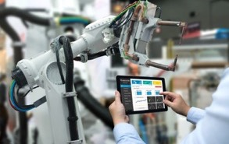


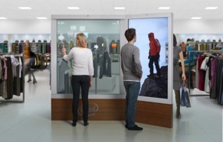
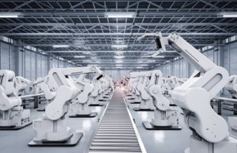
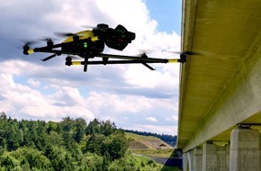
Emergency Response
Financial services
Machine Vision
Cities/transportation
Video: The “eye of IOT”
Use of video, computer vision and deep learning is growing rapidly
Autonomous Vehicles
Responsive Retail
Manufacturing
Public sector
Notes:
Advanced medical research, personalized healthcare, smart transportation, cities, manufacturing, retail, supply chain management—the industries that rely on video for critical insight and competitive growth are everywhere.
Up to $11 billion in edge to cloud industry growth is expected between now and 2021. Video captured at the edge by smart devices, sensors, and connected things represents a huge portion—$6 billion—of this IoT opportunity for everything from smart manufacturing to smart cities.

Slide 6
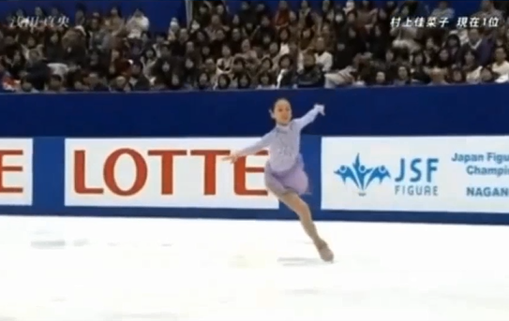

Deep Learning Usage is Increasing
Deep learning revenue is estimated to grow from $655M in 2016 to $35B by 2025¹
Image Recognition
Traditional Computer Vision Object Detection
Using Deep Learning
Error
Deep Learning Computer Vision person
recognition
person
Human
2010
Present
Market Opportunities + Advanced Technologies have Accelerated Deep Learning Adoption
¹Tractica 2Q 2017
Notes:
Slide Message: DL is often much more robust than conventional CV methods and hence much more accurate across a broader range of objects and scene conditions. The developer will need to assess whether the increased computation and robustness is required versus traditional CV methods for the particular use case

Slide 7
Deep learning: Training vs. inference
Training
Did you know?
Human
Bicycle
Training requires a very large data set and deep neural network (i.e. many layers) to achieve the highest accuracy in most cases
Forward
“Strawberry”
?
“Bicycle”
Lots of labeled data!
Backward
Error
Strawberry
Large NN
Inference
Model weights
Accuracy
Medium NN
Small NN
Traditional Model
Forward
“Bicycle”?
Data set size
??????
Notes:
In this presentation, we will often refer to the process of “training” a deep neural network (DNN) and the process of using the trained DNN for “inference”. This slide is meant to be a quick primer on the difference between the two.
In the example shown, the job of the DNN is to be able to classify the input picture into one of three different categories – a person, a bicycle, or a strawberry.
Lots of labeled training data is passed in to the network in a “forward pass”. With each new piece of training data, the network makes a prediction about what the image is. In the training example shown, the DNN predicts that the bicycle is a strawberry. So it has made an error.
In the “backward pass”, the error propagates back through the network and the weights – i.e., the interconnections between the artificial neurons – are updated to account for the error. Once these updates have been made, the next time the same image is passed into the DNN, the DNN will be more likely to predict that it’s a bicycle.
When the training process has been completed and the DNN is making predictions with sufficient accuracy, then the model weights are frozen, and the trained model can be used for inference.
The same types of operations that are done for training must also be done for inference. In fact, as we’ve explained, training involves inference! So you could certainly use a processor designed for training to do inference. However, the use cases of training and inference are not the same, which often implies different processor requirements.
With training, you want to run through a large number of computations on the order of exaflops (a billion billion operations!) as fast as possible, all at once. Training is typically done in a data center, where processor power and physical size are less of a constraint.
Inference, on the other hand, must happen over and over again as the trained model is in use over some extended period of time. There may be strict size or power constraints – for example if the inference is happening in a smartphone or a self-driving car.
So while you could use the same processor for inference as you do for training, sometimes using alternate designs is a more optimal approach for a given use case.

Slide 8
Artificial Intelligence Development Cycle
Dataset aquisition and organization
Import
Create Models
Build
Deploy
Train
Today’s focus:
Integrate trained models with application code
Adjust models to meet performance and accuracy objectives
Intel® Deep Learning Deployment Toolkit: Deploy optimized inference from Edge to Cloud
Notes:
Build
In order to achieve our vision for artificial intelligence, we must address each phase of the AI development cycle. Data scientists today are forced to spend unacceptable amounts of time preprocessing data, iterating on models and parameters, waiting for training to converge (compute-bound), and experimenting with deployment models, with each step being either too labor or compute intensive.

Slide 9


Intel® Computer Vision SDK & Components
What’s Inside the Intel® Computer Vision SDK
Intel® Deep Learning Deployment Toolkit
Component tools
Traditional Computer Vision–All SDK versions
Optimized Computer Vision Libraries
Model Optimizer Convert & Optimize
OpenCV*
OpenVX*
Increase Processor Graphics Performance–Linux* only
Trained Models
Intel® Media SDK (open source version)
OpenCL™ Intel® Integrated Graphics Drivers & Runtimes
IR
Inference Engine
Optimized Inference
Linux for FPGA only
FPGA RunTime Environment (RTE) (from Intel® FPGA SDK for OpenCL™)
Bitstreams
CPU
GPU
FPGA
VPU
GPU = CPU with Intel® Integrated Graphics Processing Unit
VPU = Movidius™ Vision Processing Unit
OpenVX and the OpenVX logo are trademarks of the Khronos Group Inc.
OpenCL and the OpenCL logo are trademarks of Apple Inc. used by permission by Khronos
Notes:
Intel® Computer Vision SDK is designed to increase performance and reduce time to market for computer vision solutions. It simplifies access to the benefits from the rich set of hardware options available from Intel which can increase performance, reduce power, and maximize hardware utilization – letting you do more with less and opening new design possibilities.
Deep Learning Deployment Toolkit
A Cross-platform Tool to Accelerate Deep Learning Inference Performance
Inference Engine, with plugins for CPU, GPU and FPGA – what it is… across multi-platform support
Model Optimizer, converting Caffe, TensorFlow, and MXnet to IR. (Note: TensorFlow and MXNet are preview only in R3.)
OpenCV
Pre-compiled OpenCV 3.3
Full Intel CPU optimizations
New Intel Photography Vision Library, with face detection/ recognition, blink detection, and smile detection
OpenVX
Graph-based implementation of a short list of traditional CV operations and CNN primitives.
Khronos OpenVX* Neural Networks Extension 1.2
Visual Algorithm Designer
Eclipse* plugin enabling integrated OpenVX* application development

Slide 10
Choosing the “right” hardware
Power/performance efficiency vary
Running the right workload on the right piece of HW → higher efficiency
HW acceleration is a must
Heterogeneous computing?
Trade offs
Power/ performance
Price
Software flexibility, portability
X100
Vision Processing Efficiency
Dedicated Hardware
Vision DSPs
X10
FPGA
Power Efficiency
GPU
CPU
X1
Computation Flexibility
Notes:
So we want to run the right task on the best, most efficient silicon device.
Considering the tight requirements for power and performance, it is obvious that in order to be competitive we must use accelerators.
But what if my workload consist of many different tasks, some tasks will run better on CPU, Some better on GPU and so on?
Can I run each portion of the code on a different device?
This is what we call Heterogeneous computing,
Balancing a workload across multiple devices is a tricky task, and need to take into account more than just the compute power of the accelerator
Transferring the data to and back from the accelerator (for example) might kill the benefit of using it at all.
How to know? Usually it’s best to just try, I’ll show an example.
So we need to consider all of these factors and more.
The good news is that Intel has a wide range of silicon solutions we can choose from…
We cannot discuss all of the tradeoffs and the options here, but let me refer you to performance.intel.com XXXXX

Slide 11
Intel® Computer Vision SDK Performance
Baseline Caffe* Framework - Out of Box = 100%
Optimize it
Use Intel Tools
Or offload to Intel® Iris™ Pro Graphics
Or offload to Intel® FPGA
Public models | Batch Size |  | OpenCV* optimized (non-Intel) | Intel® CV SDK on CPU |  | Intel CV SDK w/ Floating Point 16 (FP16)¹ |  | Intel CV SDK on Intel® Arria 10-1150GX FPGA
Squeezenet* 1.1 | 1 |  | 431% | 425% |  | 564% |  | 1,623%
Vgg16* | 1 |  | 174% | 549% |  | 295% |  | 435%
GoogLeNet* v1 | 1 |  | 330% | 577% |  | 448% |  | 1,619%
SSD 300* | 1 |  | 185% | 448% |  | 248% |  | 819%
Squeezenet* 1.1 | 32 |  | 466% | 759% |  | 663% |  | 2,016%
Vgg16* | 32 |  | 188% | 434% |  | 321% |  | 791%
GoogLeNet* v1 | 32 |  | 385% | 715% |  | 497% |  | 1,895%
Intel® Computer Vision SDK Accelerates Performance of Deep Learning Models running on Intel Hardware
→ Get Faster Results with Less Work
¹Accuracy changes can occur w/ FP16
Benchmark results were obtained prior to implementation of recent software patches and firmware updates intended to address exploits referred to as "Spectre" and "Meltdown". Implementation of these updates may make these results inapplicable to your device or system. For more complete information about performance and benchmark results, visit www.intel.com/benchmarks.
Configuration: Intel® Core™ i7-6700K CPU @ 2.90GHz fixed, GPU GT2 @ 1.00GHz fixed Internal ONLY testing, performed 4/10/2018 Test v312.30, Ubuntu* 16.04, Intel® Computer Vision SDK 2018 RC4. Tests were based on various parameters such as model used (these are public), batch size, and other factors. → Different models can be accelerated with different Intel hardeware solutions, yet use the same Intel software tools!
Benchmark Source Intel Corporation. See full details in Backup Slide
Intel’s compilers may or may not optimize to the same degree for non-Intel microprocessors for optimizations that are not unique to Intel microprocessors. These optimizations include SSE2, SSE3, and SSSE3 instruction sets and other optimizations. Intel does not guarantee the availability, functionality, or effectiveness of any optimization on microprocessors not manufactured by Intel. Microprocessor-dependent optimizations in this product are intended for use with Intel microprocessors. Certain optimizations not specific to Intel microarchitecture are reserved for Intel microprocessors. Please refer to the applicable product User and Reference Guides for more information regarding the specific instruction sets covered by this notice. Notice revision #20110804
Notes:
From internal benchmark worksheet 3.12.30
Tested topologies are split into 2 types: Public - topologies reported in papers and publicly available. Intel - topologies that are used @ Intel (either developed for customer enabling, own products or experimental results). Readiness of the topology indicates maturity of the product (Research->POC->Internal Reference-> Near Production Worthy-> Production Worthy) Testing methodology: - End 2 End. Each topology is passed through Model Optimizer and executed on target hardware for Inference Engine. For caffe, no modifications on model are done. - Results of execution are compared against caffe version. Error threshold is as follows: - 10e-4 for classification networks - 1 pixel difference in bounding box coordinates + 10e-4 difference in confidence for detection networks - Each network is executed for at least 20 seconds in a loop, minimum 10 executions done. Measured times are filtered to take 3 Sigma range. Other measurements are discarded. Out of remaining measurements, median value is taken. HW and SW details for targets are described in detail on System Configuration spreadsheet. Benchmark results in FPSes are reported on Benchmark results spreadsheet. Color codings are as follows: Fastest framework for target Results do not match caffe reference Test did not finish Test was not run Column descriptions: MaxMem is a theoretical memory consumption of the network for inference considering that memory is NOT reused, i.e. if all internal feature maps are stored in memory simultaneously. MinMem is absolute minimum of memory that network needs for inference. I.e. largest of needs from all layers. MaxMem and MinMem are measured in millions of activations (to get actual memory size multiply by activation size, i.e. fp16 for Movidius). Does not consider weights, those are shown in Mparam. Gflop number are actual operations, not MACs. Counted for known layers (mostly convolutions, FCs, etc.). Custom layers are not considered. Mparam numbers are reported for known layers only. Number is actual amount of parameters. To get amount of bytes number should be multiplied by size of weight (e.g. fp16 for Movidius). Input image is given as a size of first input blob for a network. Network execution time is split into times taken by individual layer types (Convolution, Pooling, etc.). Breakdown is reported for each topology, target and plugin on Execution breakdown spreadsheet. 100% correspond to entire network time. %% number indicates to relative number that individual layer type takes. Layer types and their parameters that are used by each topology are reported on Layers per toplogy list. Number on this sheet shows how many times particular layer with given parameters is used in a topology.

Slide 12
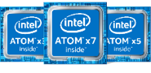
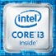

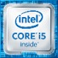



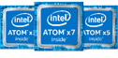


Intel IoT Video Portfolio Intel is investing in AI, computer vision and deep learning for IoT
Smart Cameras
Video Gateways/NVRs
Data center / Cloud
FPGA solutions from intel
CV
Intel® Media SDK, Intel® Computer Vision SDK
Industry’s Broadest Media and Computer Vision and Deep Learning Portfolio
Notes:
Intel is in a unique position provide the market with an E2E solution that addresses the pain points around bandwidth, storage cost, security, and real time response while also providing the right performance/watt for the DL workload that is needed to make systems predictive vs. forensic and support operational and business intelligence the market desires.
We have amassed the most complete silicon portfolio in the industry
Three key points:
Right silicon for every node
Security across every node
Common SW tools to Optimize perf across all nodes
from Camera to Cloud:
Edge (Camera)
Physical Constraints – Power and Size (small FF). Economical Constraints - Cost
Performance Efficiency – max performance within tight budgets
Latency – for Real-time use cases
Gateway/Recorder - as video aggregators, video gateways ingest and process multiple camera streams simultaneously (8-100s). Manufacturers are ramping support for more and more of those channels with AI processing.
Channel density - Performance/$
DC/Cloud – far less margin pressure – seeking high density media and DL throughput, with flexibility to scale.
Absolute Performance Throughput (images/S)
We have solutions across the entire system architecture
we will provide Flexibility: optimize tradeoffs for throughput, latency, and cost

Slide 13
Deep Learning vs. Traditional Computer Vision Intel® Computer Vision SDK has tools for an end to end vision pipeline
Intel® Computer Vision SDK
Intel® SDK for OpenCL™ Applications
Intel®
Media SDK
OpenCV*
OpenVX*
API Solution
API Solution
Direct Coding Solution
Pre-trained Optimized Deep Learning Models
Deep Learning Deployment Toolkit
Computer Vision Libraries
Custom Code
Model
Optimizer
Inference
Engine
Intel Hardware Abstraction
Layer
OpenCV*/OpenVX*
OpenCL™
C/C++
CPU
GPU
FPGA
VPU
CPU
GPU
CPU
GPU
DEEP LEARNING Computer Vision
TRADITIONAL Computer Vision
Based on application of a large number of filters to an image to extract features.
Features in the object(s) are analyzed with the goal of associating each input image with an output node for each type of object.
Values are assigned to output node representing the probability that the image is the object associated with the output node.
Based on selection and connections of computational filters to abstract key features and correlating them to an object
Works well with well defined objects and controlled scene
Difficult to predict critical features in larger number of objects or varying scenes
OpenVX and the OpenVX logo are trademarks of the Khronos Group Inc.
Notes:
Key Takeaways
CV SDK has tools for both Traditional and Deep Learning CV
Multiple Intel tools (Media SDK, CV SDK, ISS) work together to provide a complete CV pipeline optimization solution
Using CV SDK allows developer to maximize HW performance by using common API without having to go to the Metal
Easy to incorporate deep learning with the Deep Learning Deployment Toolkit
Trad. And DL are not mutually exclusive
OpenCL is used for:
required to run with GPU target (clDNN) using Intel® Processor Graphics
custom kernels
other kernels can be used for other non-inference pipeline stages, such as color conversions
Media SDK – API to access intel Quick Sync Video – hw accelerated encoding, decoding and processing
H.265, H.264, MPEG-2 and more
Resize, scale, deinterlace, color conversion,, composition, denoise, sharpen and more
Outstanding perf., rich API to tune pipeline, support new proc. w/o code change

Slide 14
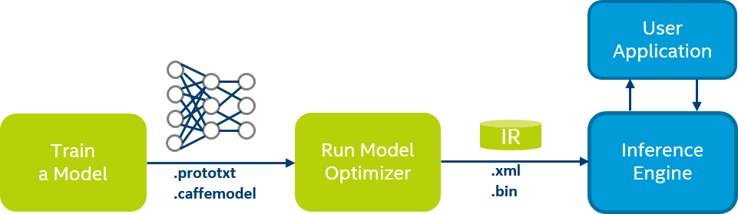



Train
Train a DL model
(out of our scope)
Currently supporting
Caffe
Mxnet
TensorFlow
Prepare
Optimize
Model Optimizer
-Converting
-Optimizing
-Preparing to inference
(device agnostic,
Generic optimization)
Inference
Inference-Engine
a lightweight API
To use in your
application for
inference
Optimize/
Hetero
Inference-Engine
Support multiple devices
For heterogeneous flows
Device level optimization
Extend
Inference-Engine
Support extensibility
And allow custom
Kernels for various
devices
MKL-DNN
CPU: Xeon/Core/Atom
Extensibility
C++
cl-DNN
GPU
Extensibility OpenCL
DLA
FPGA
Extensibility
OpenCL/TBD
In work
Myriad 2/X
Extensibility
TBD

Slide 15
Full pipeline optimization
decode/ preprocess
Infer
Postprocess, encode, stream out
stage
HW acceleration
CPU
GPU
CPU
GPU
FPGA
VPU
CPU
GPU

Slide 16
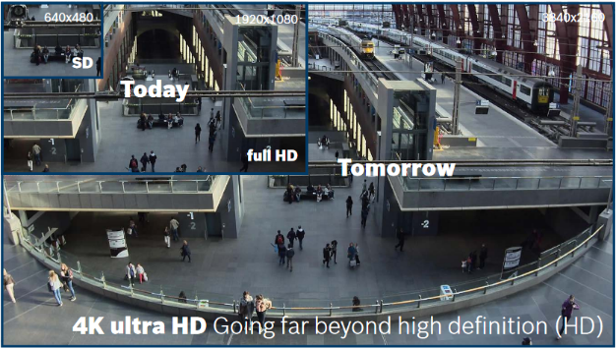
More compute power
Higher NW bandwidth
More storage
Better accuracy
Faster detection
Higher resolution
Notes:
The problem is that with higher resolution there is a need for higher bandwidth to stream all this data,
Need much more compute power to compress and uncompress it, and to analyze it
Need more storage area etc..
The key to dealing with big data is efficiency

Slide 17





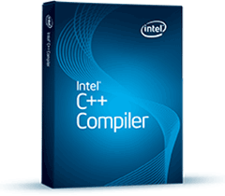

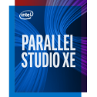


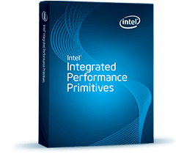
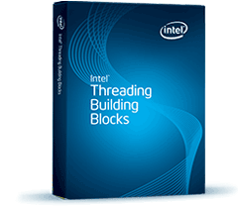


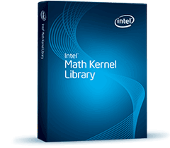

Intel Computer Vision SDK: OpenCV for computer vision applications,
Deep Learning deployment toolkit for inference
Intel Media SDK: Encode/decode, video processing
Computer Vision
Deep Learning
Media
Optimized CV
capabilities
Deep Learning
Deployment Toolkit
SDKs
MediaSDK
OpenCV
Computer-Vision SDK
Tools
Compiler, Analyzers, Debuggers
OpenCL SDK
IPP
TBB
MKL-DNN
CL-DNN
Intel® MKL
Libraries
OpenCL
DAAL
Intel Dist

Slide 18
Intel integrated Graphics
System Agent
(Display, Memory and I/O Controls)
Gen is the internal name for Intel’s on-die GPU solution. It’s a HW ingredient with various configurations
Intel Core® Processors include Gen hardware
Gen GPU can be used for graphics, and also as a general compute resource
Libraries contained in Intel® CVSDK (and many others) support Gen offload using OpenCL
CPU
core
CPU
core
Memory & IO Interfaces
Shared Last-Level Cache
CPU
core
CPU
core
Gen 9 GPU
6th Generation Core i7 (Skylake) Processor

Slide 19
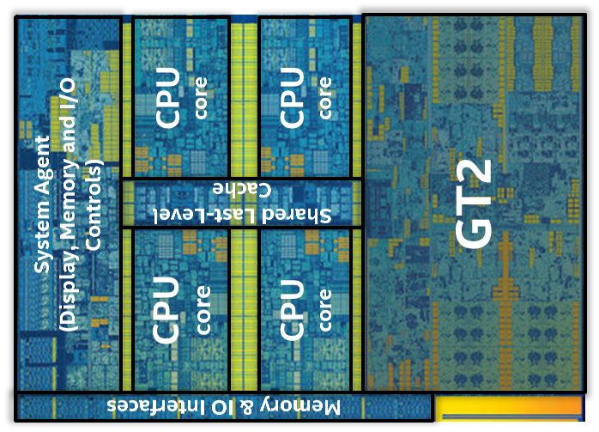
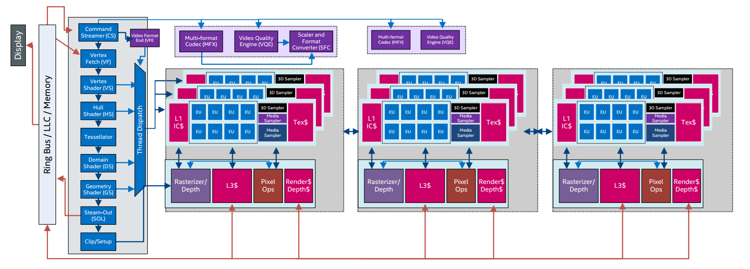
Intel GPU has various configurations
GT2
Intel® HD Graphics
24 EUs, 1 MFX
GT3
Intel® Iris™ Graphics
48 EUs, 2 MFX
GT4
Intel® Iris™ Pro Graphics
72 EUs, 2 MFX
Notes:
More info on what we mean by GT levels
Scalable design for multiple price/power targets
Slice architecture: 3 subslices with 8 EUs each make a slice. There can be 1, 2, or 3 slices. These map to the names on ark.
There is also “the rest of the GPU” – the “unslice”. This is where the fixed function lives.
These HW units have multiple names:
MFX=VDBox. (Video box)
VQE = VEBox. (Video enhancement box)
There is excellent documentation on these from 01.org.

Slide 20
Smart video Workshop Overview
Introduction
2. Basic End to End Object Detection Example
Classification
Introduction to Intel® technologies for deep learning inference
Hardware acceleration techniques
H/W Acceleration
3,4,5. HW Acceleration with CPU, Integrated GPU, Intel® Movidius™ NCS, FPGA
Each Module contains a hands-on lab exercise that will introduce to various Intel technologies to accelerate computer vision application with hardware heterogeneity.
6. Optimization Tools and Techniques
Optimization
7. Advanced Video Analytics
Application

Slide 22



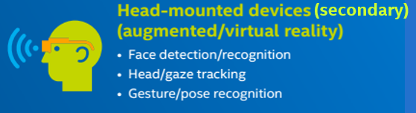

Target Markets & Use Cases
Retail
Industrial
+ retail, industrial automation, etc
$$
Office Automation
Optical Recognition
Image Recognition
Print Imaging
Autonomous Vehicles Lane Detection
Object Recognition
Common Use Cases & Workloads
Leveraging a heterogeneous compute environment
Processing images and videos
Managing domain-specific workloads (ie detecting lanes/license plates, parking lot monitoring, face recognition, etc.)

Slide 23
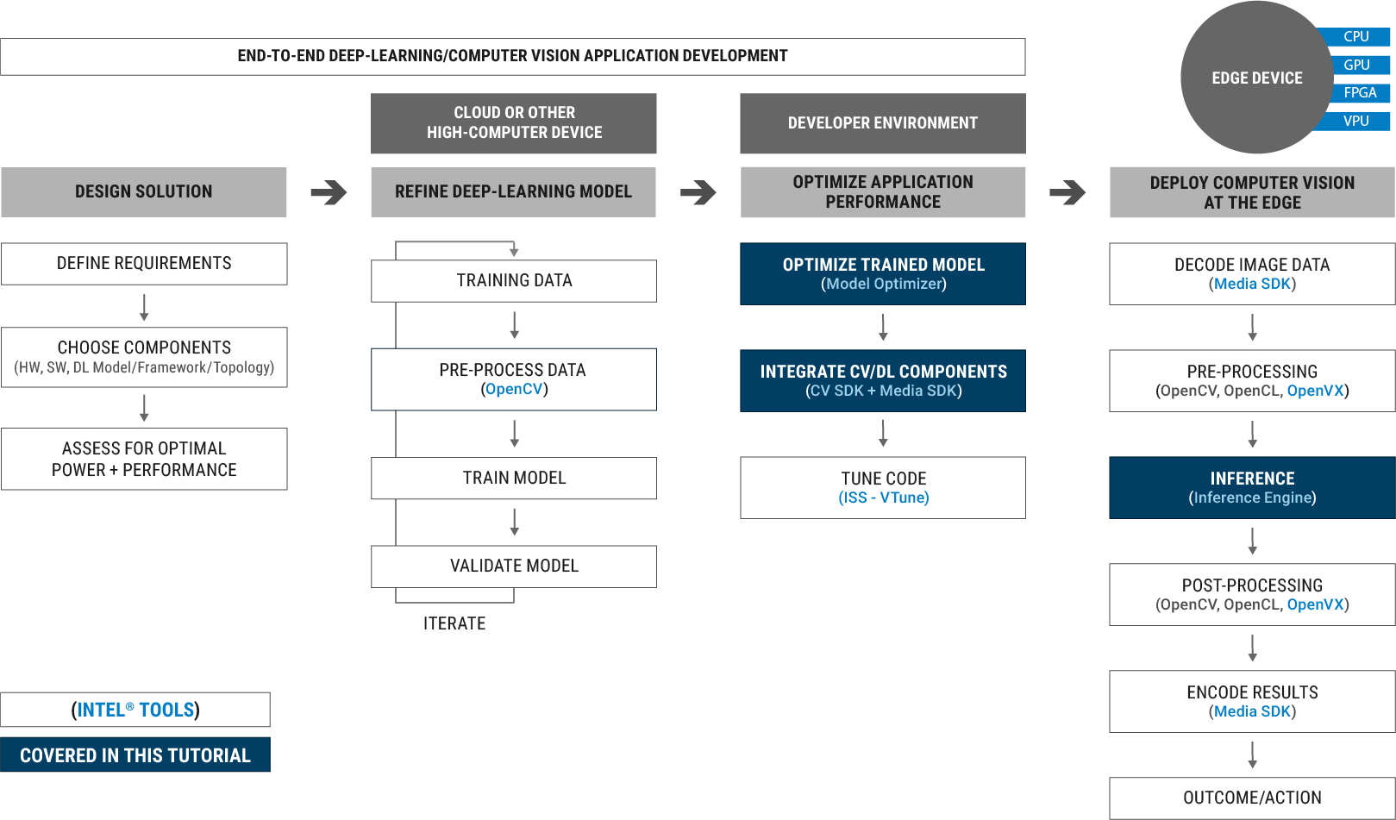
End 2 End CV Application Development Flow

